Slide 1
Assignment

Slide 2
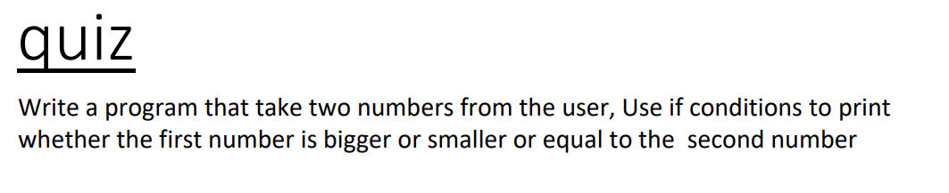

Slide 3
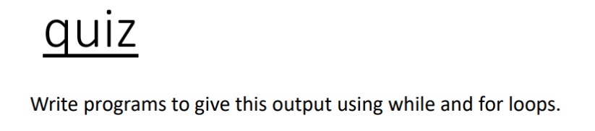
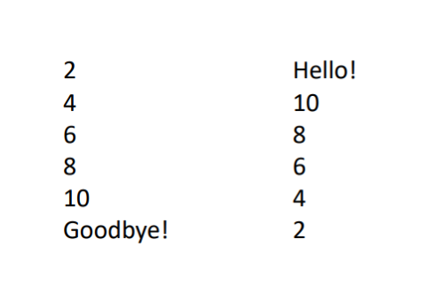

Slide 4
Program to calculate the sum of all natural numbers till a specific numbers.
For example: End = 4
You should compute : 1+2+3+4
Then print 10

